Slide 1
Tutorial #23
GEF In Depth
Randy Hudson
Pratik Shah
IBM Rational Software Research Triangle Park, NC

Slide 2
Agenda
Start things off
What is GEF?
GEF Demo
Draw2d
  Overview
  Example
GEF
  Overview
Break
Hands-on Activity: Shapes Example

Slide 3
Starting things off…
This is an interactive session: feel free to ask questions
Goals for this tutorial
  Introduce GEF and Draw2d
  Highlight main features
  Show how to find answers easily
  Provide hands-on experience
  Steer you around common mistakes
Tell us about your GEF Plans
  Level of experience with GEF?

Slide 4
Before we begin…
Newer version of these slides are available
  GEF Home Page -> Click on Documentation
  http://www.eclipse.org/gef/reference/articles.html
You’re going to need:
  Eclipse 3.1M5a
  GEF SDK 3.1M5
  Files for tutorial: unzip into your workspace before launching Eclipse, and then from within Eclipse, Import -> Existing Project Into Workspace
    http://www.eclipse.org/gef/conference/activity.zip
We have CDs

Slide 5
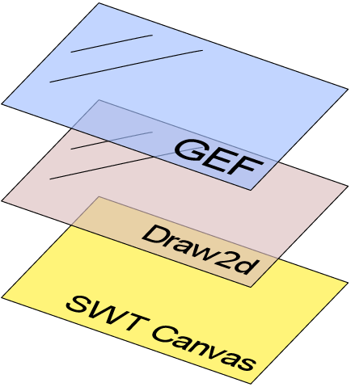
What is GEF?
Interaction Layer
Model-to-View mapping
Workbench Integration
Rendering
Layout
Scaling
Native (SWT) Layer

Slide 6
GEF Components & Dependencies
GEF
ui.views
RCP
SWT
Draw2D
Platform Runtime

Slide 7
GEF Demo
Features
  Move, Resize, Create, Bend, Connect
  Delete, Undo, Redo, Direct-editing
  Overview & Zooming
  Palette Viewer and workbench view
  Palette Customization
  Rulers & Guides
  Snap-To-Grid or Geometry
  Shortest Path Connection Router
  Keyboard Accessibility
  Directed Graph Layout

Slide 8
Draw2d Overview
Draw2d : SWT :: Swing : AWT
Lightweight Toolkit built on top of SWT
Concepts borrowed from Swing and others
Built to support GEF function

Slide 9
Draw2D Lightweight System
FigureCanvas
SWT Canvas
LWS
UpdateManager
Root Figure
EventDispatcher
Contents
Content Root
Figure
Figure
Figure

Slide 10
Figures
Simple lightweight container: building block
  Fonts, Colors, Opacity, Borders, Layouts, Visibility, Bounds, Tool-tip
  Inherit parent’s font and color (RootFigure gets it from the Canvas)
Can be non-rectangular
Can be nested
Bounds
Client Area
(children paint here)
Insets

Slide 11

Hello World
1
2
3
4
5
6
7
8
9
10
11
12
Display d = new Display();
Shell shell = new Shell(d);
shell.setLayout(new FillLayout());
FigureCanvas canvas = new FigureCanvas(shell);
canvas.setContents(new Label("Hello World"));
shell.setText(“draw2d”);
shell.open();
while (!shell.isDisposed())
while (!d.readAndDispatch())
d.sleep();

Slide 12
Painting and Finding Figures
Figures form a tree
Painting is pre-order, “LTR”
Parents clip children
Last painted is “on top”
Hit-testing is the opposite
1
2
3
6
1
6
2
3
4
5
4
5

Slide 13
Painting continued
Override paintFigure(), not paint()
  You don’t have to worry about maintaining the state of the Graphics object; change settings as you please
  Order of painting: parent figure, children figures, parent’s border
Request repaint() when any property that affects the appearance is changed
Double-buffered painting (no flicker)

Slide 14
LayoutManagers
Responsibilities
  Position a Figure’s children: IFigure#setBounds()
  Provide the preferred sizes based on children and layout
  Only invalid figures will layout
Hints passed during size calculations
  -1 means not confined in that direction
  AbstractHintLayout caches sizes based on hints
Scrollbars’ visibility determined by preferred size
Constraint ≈ SWT’s LayoutData
  Example: XYLayout uses Rectangle constraints

Slide 15
Layout Managers in Draw2d
BorderLayout
FlowLayout
Top
1
2
Left
Center
Right
3
4
Bottom
XYLayout
ToolbarLayout
1
2
3
12,8,20,10
30,20,27,14

Slide 16
Using Layout Mangers
Layouts place children within the parent’s “client area”
Borders can be used to modify the client area
The included layouts can get you far
Nest Layouts/Figures to get results
Layout Managers must not be shared
Borders may be shared (singletons)

Slide 17

User Interaction Scenario in Draw2d
FigureCanvas
LWS
SWT
EventDispatcher
1. interacts with
2. Listener notifies
3. delegates to
6. validates invalid figures then paints dirty region
4. dispatches figure events
Deferred
UpdateManager
5B. revalidates and marks roots as invalid
Root Figure
Contents
Content Root
5A. requests repaint of dirty region
Figure
Figure
Figure
Figure
Figure

Slide 18
Coordinate Systems
By default, bounds of parent and children use same coordinates
Relative Coordinates
  useLocalCoordinates()
  Child positioned relative to parent’s client area
Scaling and Translation
  Viewport
  Zoom
Converting coordinates
  translateToParent() – Translate to parent’s coordinate system
  translateFromParent() – Translate from parent’s coordinate system to child’s
  translateToAbsolute() & translateToRelative()

Slide 19
Displaying Text
org.eclipse.draw2d.Label
  Icon + Text
  Truncation, Alignment
  Tip: Use ImageFigure if you only have Images
Improved “Rich” Text features in 3.1
  org.eclipse.draw2d.text package
  Content which wraps itself like a paragraph
  Margins, borders and padding
  Mixing non-textual components with text
  API for finding offset based info
  BiDi – Arabic, Hebrew, etc.

Slide 20
Connection extends IFigure
Just Figures with special behavior
Render a PointList managed by a ConnectionRouter
Have a source and target ConnectionAnchor
  Define the start and end points of the connection
  Return locations using absolute coordinates
  #getLocation(referencePoint)
  Context sensitive (ChopBoxAnchor or EllipseAnchor)
Routers
  Responsible for setting all points in a connection
  May use routing constraints such as Bendpoint
  Examples: Fan, Bendpoint, Manhattan, ShortestPath

Slide 21
Connections continued
Connection can have children too
  Arrowheads, Labels, etc.
DelegatingLayout
  Locator constraints position each child
Connections set their own bounds after validating
  Do not call setBounds() on connections

Slide 22
Connections et al
Labels placed using ConnectionLocators
Fig 2
u
Endpoint
}
v{
Anchor Location
Midpoint
PolylineConnection
Fig 1
-4
-3
-2
-1
2
PolygonDecoration
1
-1
-2

Slide 23
Avoiding Common Mistakes
Do not modify Objects returned by reference (e.g., bounds)
Use revalidate() and repaint() appropriately
Polyline is not a regular Shape
Know your coordinate systems
Use LineBorder as a debugging tool
Can’t ask for preferred sizes without Fonts
news://news.eclipse.org

Slide 24
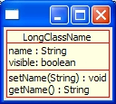
Draw2d Exercise
Build the following representation of a UML Class
Use only the provided classes:
  ToolbarLayout
  LineBorder
  MarginBorder
  Label (not SWT’s)
  ColorConstants
Pack the SWT shell to auto-size
Figure structure:
class
heading
methods
attributes
attr1
method
attr2
method

Slide 25
The Solution

Slide 26
The GEF plug-in
Interaction Layer
Model-to-View mapping
Workbench Integration

Slide 27
What Problems does GEF Solve?
Display a Model graphically
Allow the User to interact with that model
  Process user input from Mouse & Keyboard
  Interpret that input
  Provide hooks for updating the model
  Make it undo/redo-able
Provide useful Workbench function
  Actions and Menus
  Toolbars, Contributions
  Keybindings
Where Can I use GEF?
  EditorParts, Views
  Anywhere in the Workbench

Slide 28
Displaying a Model Graphically
Figures are not your model
Lots of models to choose from (EMF, DOM)
GEF works with any model
Model requirements:
  Notification mechanism
  Persist and restore state
  Commands which operate on the model

Slide 29
Displaying a Model Graphically
GraphicalViewer
  Viewer == Adapter for a Control
  Manages Draw2d’s Figures
Construct a Viewer and Canvas
TreeViewer uses Tree
Set the model input for the Viewer
Next: Map the Model into Figures

Slide 30
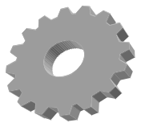
Populating a Viewer
GraphicalViewer
EditPart
Factory
Model
EditParts
Figures
@#!
Notes:
Usage of MVC
Mapping from Model-part-figure not always 1:1
An EditPart is its own local ContentProvider

Slide 31
Graphical EditParts and Containment
“Diagram”
EditPart
Model Root
(Diagram)
fig
Children
…
fig
fig
…
…

Slide 32
Extending AbstractGraphicalEditPart
createFigure()
  Just builds the figure
refreshVisuals()
  Reflect the model’s state in the view
getModelChildren()
  Determines children to create
Looking ahead:
  Changing the model
  Responding to model changes

Slide 33
Connection EditParts
Similarities to children parts:
  Return a list of model objects:
  getModelSource/TargetConnections()
  Factory can create the Connection Parts
Differences:
  An anchor must be set for the source and target
  Target may come before Source
  Figure gets added to the Connection Layer
NodeEditPart Interface
Connection must have a direction

Slide 34
More about EditParts
Deciding on Model → EditPart mapping
  Unit of “interaction”
  Selection is comprised of EditParts
  Can it be deleted?
  Graphical vs. Tree Viewers
The Root EditPart

Slide 35
Editing: Putting the “E” in GEF
_{Requests}
_{Commands}
GraphicalViewer
Model
EditParts
Figures
@#!

Slide 36
Editing and Tools
EditPart
Tool
EditPart
EditPolicy
EditPolicy
EditPolicy
SWT Canvas
SWT Events
Requests
Requests
showFeedback()
eraseFeedback()
getCommand()
Commands
Commands
Stack
?
Commands

Slide 37
EditParts and EditPolicies
EditPolicies are installed and maintained by their host part
EditPart responsibility is keep view up-to-date
EditPolicies handle editing tasks
  Avoid limitations of single inheritance
  Separate unrelated editing tasks
  Allows editing behavior to be dynamic
  Keyed using Strings (“Roles”)
  May contribute to feedback, commands, targeting, etc.
  Tip: UnexecutableCommand vs. null
  Examples: BendpointEditPolicy, SelectionEditPolicy, etc.
Pattern used: “Pool of Responsibility”

Slide 38
Responding to Model changes
Extend activate() to hook listeners
Extend deactivate() to unhook listeners
Depending on the type of change
  Add, remove, or reorder Children
  Update Connections
  Update the view

Slide 39
Building a GEF Application
Step 1:
Model
Edit Policies
Step 2:
View
Add Editing
Behavior
Property Sheet
Step 3:
Controller
Palette and Tools
Step 4:
“Editor”

Slide 40

The Big Picture
EditDomain
EditPartViewer
EditPartViewer
EditPartViewer
1. acts on
Model
2. events
3. request
4. command
Palette
CommandStack
Tool1
5. execute
Command
6. modifies
Active
Tool
Tool2
Command
Command
Tool3
Command

Slide 41
GEF – Conventions and Patterns
Tools to interpret mouse and keyboard
Requests to encapsulate interactions
  Tip: performRequest() for REQ_DIRECT_EDITING and REQ_OPEN
Absolute coordinates
Edit Policies for separation of concerns
Command pattern for undo/redo
Use of IAdaptable

Slide 42
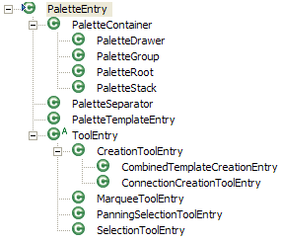
Palette
PaletteViewer: Just another GraphicalViewer
  Tip: #saveState(IMemento)
Palette Model
  Templates vs. Tools
  Drawers, Groups and Stacks
  Permissions
PaletteViewerProvider
  Add drag source listener for DND
Fly-out Palette and PaletteView
  GraphicalEditorWithFlyoutPalette
  PalettePage
  FlyoutPreferences

Slide 43
Properties View
Implement IPropertySource on
  The EditPart
  The Model
    Or make the model IAdaptable
  A Custom adapter for combining multiple sources
GEF provides undo/redo support via commands
UndoablePropertySheetEntry
  Auto-Wraps IPropertySource changes in a Command

Slide 44
Outline View
Use the provided TreeViewer class
Extend AbstractTreeEditPart
Use SelectionSynchronizer with multiple viewers
Editor actions can be reused in the outline
Use ScrollableThumbnail as an Overview

Slide 45
Actions
Editor’s ActionRegistry
  Actions updated as needed
    Editor does the listening, not the actions
  It’s just a Map
ActionBarContributor
  One for all editor instances
  Declared in plugin.xml
  Use RetargetActions

Slide 46
Accessibility
Eclipse is accessible
GEF is accessible
IAdaptable#getAdapter(Class)
  AccessibleEditPart
    Magnifier and Screen reader API
Focus indication (Selection Edit Policies)
Default keyboard handlers
Accessible Tools
  AccessibleAnchorProvider
  AccessibleHandleProvider

Slide 47
Auto-Scrolling
During drag operations, including native DND
Search from target part upwards
AutoExposeHelper
  #detect(Point)
  #step(Point)
Not just for scrolling
  Expanding
  Page-flipping
Related: ExposeHelper
  Programmatically “reveal” an EditPart

Slide 48
Zooming
ZoomManager
  Use a Scalable RootEditPart
  Tip: available as a property on the viewer
Action Contributions
  Zoom-In & Zoom-Out Actions
  ZoomComboContributionItem
Ctrl + MouseWheel (in 3.1)
  MouseWheelZoomHandler

Slide 49
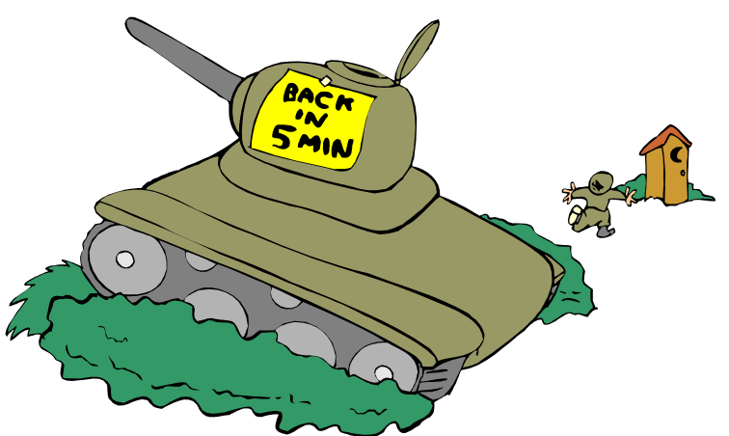
BREAK
10 minutes

Slide 50
Set-up
Install Eclipse 3.1M5a and GEF SDK 3.1M5
Start with a clean workspace
Unzip activity.zip into your workspace before launching Eclipse, and then from within Eclipse, Import -> Existing Project Into Workspace
  http://www.eclipse.org/gef/conference/activity.zip
Switch to the Java Perspective

Slide 51
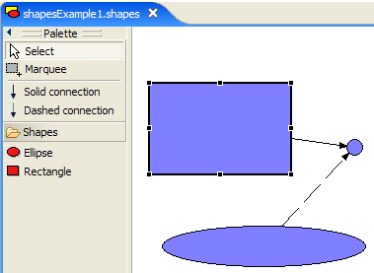
Hands-on Activity: Shapes Example
Create your own plug-in
  Based on the simple Shapes example contributed by Elias Volanakis
  Skeleton provided for the plug-in

Slide 52

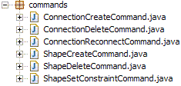
Model
Provided!
So are the Commands
ModelElement implements IPropertySource and Serializable

Slide 53
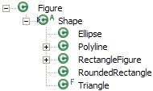
View
Available in Draw2d
Basic Shapes: RectangleFigure and Ellipse

Slide 54
Controller
ConnectionEditPart
(AbstractConnectionEditPart)
ShapeEditPartFactory
ShapeEditPart
(AbstractGraphicalEditPart)
ShapeDiagramEditPart
(AbstractGraphicalEditPart)

Slide 55
ShapeDiagramEditPart
Listen to the model only when the EditPart is active
  activate()
  deactivate()
  propertyChange()
createFigure()
  FreeformLayer with FreeformLayout if you want to scroll into negative co-ordinates; Figure with XYLayout otherwise
getModelChildren()
createEditPolicies()
  COMPONENT_ROLE: RootComponentEditPolicy (provided by GEF) to prevent deletion of the content EditPart
  LAYOUT_ROLE: Subclass XYLayoutEditPolicy
    For creating, moving and resizing children
    createChildEditPolicy() : default will do

Slide 56
ShapeEditPart
Listen to the model for changes
Create RectangleFigure or Ellipse based on the model instance
Implement NodeEditPart to support connections
ChopboxAnchor or EllipseAnchor (return the same anchor in all methods)
Edit Policies
  COMPONENT_ROLE: Sub-class ComponentEditPolicy to provide delete support
  GRAPHICAL_NODE_ROLE: Sub-class GraphicalNodeEditPolicy
getModelSourceConnections() and getModelTargetConnections()
refreshVisuals()
  ((GraphicalEditPart)getParent()).setLayoutConstraint(…)

Slide 57
ConnectionEditPart
Listen to model for changes
Create figure
  PolylineConnection with a target decoration and proper lineStyle
Edit Policies
  CONNECTION_ENDPOINTS_ROLE: ConnectionEndpointEditPolicy (provided by GEF) to select the connection’s endpoints
  CONNECTION_ROLE: Sub-class ConnectionEditPolicy to support delete

Slide 58
Bring It All Together - ShapesEditor
Functionality not related to GEF is provided
  We’ve added TODO:Tutorial to mark missing functionality
Constructor: Provide a new DefaultEditDomain
configureGraphicalViewer()
  RootEditPart
  EditPartFactory
initializeGraphicalViewer()
  Set the viewer’s contents
Palette
  getPaletteRoot() and getPalettePreferences()
  Delegate to ShapesEditorPaletteFactory

Slide 59
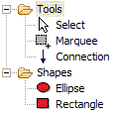
Bring It All Together - ShapesEditorPaletteFactory
createPalettePreferences()
  ShapesPlugin#getDefault()#getPreferenceStore()
createPaletteRoot()
  Tools Group has PanningSelectionToolEntry, MarqueeToolEntry and ConnectionCreationToolEntry
  Shapes Drawer has CombinedTemplateCreationEntry for the two shapes
    The templates can be null for now (used for DND)
  Tip: Do not forget to provide a default tool (usually Selection)

Slide 60
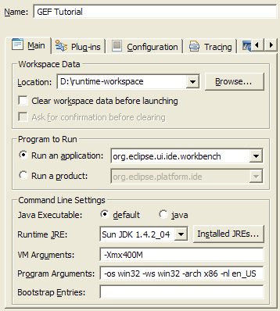
Test Drive
Launch the Runtime Workbench
  Run menu -> Debug… -> Click on Entire Application -> Click New
Test functionality
  Create a Simple Project and a new Shapes example using the wizard
  Click and drop from palette (notice drag and drop doesn’t work yet)
  Select, move, resize, connect parts
  Properties View
  Select a shape and hit ‘.’ (the period key); then try ‘/’ (the slash key)
  Bring up the Palette View
  Right-click on the palette
  Drag the shapes into negative region
From here, we’ll incrementally add desired features

Slide 61
(Native) Drag-n-Drop from Palette
Add DragSourceListener to the Palette and DropTargetListener to the graphical viewer
ShapesEditor
  createPaletteViewerProvider() - TemplateTransferDragSourceListener
  initializeGraphicalViewer() – TemplateTransferDropTargetListener
ShapesEditorPaletteFactory
  Change CombinedTemplateCreationEntries’ to return the model classes as templates
Sub-class TemplateTransferDropTargetListener to provide the CreationFactory: use SimpleFactory

Slide 62
Context Menu
ShapesEditorContextMenuProvider#buildContextMenu()
  Add Undo, Redo, Delete and Save actions from the Editor’s ActionRegistry
ShapesEditor#configureGraphicalViewer()
  Create and hook the context menu

Slide 63
Actions
ShapesEditorActionBarContributor
  All ShapesEditor instances share this Contributor
  buildActions() – Add RetargetActions for undo, redo, delete
  contributeToToolBar() – Add undo and redo retarget actions to the toolbar
    Do not create new actions here!
Register the contributor in plugin.xml where you register your editor
  contributorClass= "org.eclipse.gef.examples.shapes.ShapesEditorActionBarContributor"

Slide 64
Connection Routing
ShapesEditor#initializeGraphicalViewer()
  Get the connection layer from the RootEditPart
  Create a new ShortestPathConnectionRouter and add it to the connection layer
    Tip: Do this after the viewer’s contents have been set
  Add the router’s layoutListener to the content EditPart’s content pane (i.e., the figure that is going to have the connections)
  Voila!

Slide 65
Outline
ShapesOutlinePage extends ContentOutlinePage
  Set-up as inner class in ShapesEditor since it shares a few things with it
  Use the GEF TreeViewer
  Since we’re creating a new viewer, we’ll need to define a new EditPartFactory and new EditParts
EditPart
  Extend AbstractTreeEditPart
  Much simpler than earlier ones
    No Edit Policies needed since we’re only supporting selection
  Listen to the model for changes
  We do not show connections in the outline, so no need to worry about those
  Override getImage() and getText()

Slide 66
ShapesOutlinePage
Override createControl()
  Outline viewer should share EditDomain/CommandStack with the Editor’s viewer
  Provide the EditPartFactory
  Register the context menu for this viewer
  Register viewer with the SelectionSynchronizer
    Tip: Don’t forget to remove the viewer from the SelectionSynchronizer when the outline page is disposed – override dispose()
  Set the contents
Override init()
  Register Editor’s actions as GlobalActionHandlers (undo, redo, delete)
  pageSite.getActionBars().setGlobalActionHandler(…)
Hook with the Editor
  ShapesEditor#getAdapter()

Slide 67
Other Features
Customizer for the Palette
Zooming (already supported, but no means to manipulate it)
Grid
Snap To Geometry
Rulers & Guides

Slide 68
That’s All, Folks!
Feedback Questionnaire
Upcoming GEF session on Wednesday
  ShortestPathConnectionRouter
  New EMF-Based Example
  WYSIWYG Text Editing
For further help with GEF
  http://www.eclipse.org/gef
    Newsgroup (Do not use the Mailing List)
    Documentation
    FAQs
  Tip: Look at GEF examples to see how they handle similar problems

